Slide 1
Introduction to Cascading Style Sheets

Slide 2
CSS introduction, CSS Syntax, Concept of CSS: Creating Style Sheet, CSS Properties, CSS Styling, Working with Lists and Tables, CSS Id and Class, Creating page Layout and Site Designs CSS style sheet: External Style Sheets, Internal Style Sheets, Inline Style, The class selector: div & span tag. DOM HTML DOM, inner HTML, Dynamic HTML (DHTML), DHTML form, XML DOM.

Slide 3
Introduction to CSS
CSS stands for Cascading Style Sheets
CSS was first developed in 1997 as a way of defining the look and feel of the web pages
HTML documents can be displayed using different styles
Styles define how to display HTML elements

Slide 4
Introduction to CSS(Why CSS?)
HTML was primarily used for defining the content of a document like paragraphs, headings, etc. with no formatting
With HTML 3.2 specifications, the formatting tags like color, font, etc. were added
When HTML was used for creating user interface for large web applications, with hundreds of web pages, formatting individual web pages posed challenges
To overcome this challenge, World Wide Web Consortium(W3C) introduced the CSS

Slide 5
CSS 1
CSS1 was introduced in 1996
It is the first edition of Cascading Style Sheets
Support for several properties
A unique ‘id for each property was introduced with CSS 1
Offered enhanced features for implementing margins, borders, padding, and positioning
CSS 2
Published in 1998
Support for Bidirectional texts
New font properties such as shadows were introduced
CSS 2.1 was the last 2nd generation edition of CSS

Slide 6
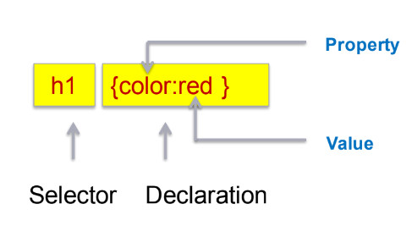
CSS 3
CSS 3 is the latest edition of Cascading Style Sheets
Several new functionalities have been provided through CSS 3
Functions like rounded corners, background decoration, and box shadows, which are demonstrated in the subsequent sections, are introduced in this version.
CSS Syntax
The CSS syntax has two main parts: a selector and one or more declarations.
Example :

Slide 7
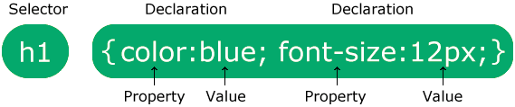
The selector points to the HTML element you want to style.
The declaration block contains one or more declarations separated by semicolons.
Each declaration includes a CSS property name and a value, separated by a colon.
Multiple CSS declarations are separated with semicolons, and declaration blocks are surrounded by curly braces.

Slide 8
Difference between HTML and CSS
HTML
CSS
HTML is a markup language used to define a structure of a web page.
It consists of tags inside which text is enclosed.
HTML doesn’t have further types.
CSS is a style sheet language used to style web pages by using different styling features.
It consists of selectors and declaration blocks.
CSS can be internal or external depending upon the requirement.

Slide 9
HTML
CSS
We cannot use HTML inside a CSS sheet.
HTML is not used for presentation and visualization.
HTML doesn’t allow animations and transitions.
HTML files are saved with .htm or .html extension
We can use CSS inside an HTML document.
CSS is used for presentation and visualization.
CSS allows animation and transitions which helps to improve the UI.
CSS files are saved with the .css extension.

Slide 10
A Simple CSS Style Example
<html>
<head>
<style>
p {
color: red;
text-align: center;
}
</style>
</head>
<body>
<p>Hello World!</p>
<p>These paragraphs are styled with CSS.</p>
</body>
</html>

Slide 11
CSS id selector
The id selector uses the id attribute of an HTML element to select a specific element.
The id of an element is unique within a page, so the id selector is used to select one unique element!
To select an element with a specific id, write a hash (#) character, followed by the id of the element.

Slide 12
Example
The CSS rule below will be applied to the HTML element with id="para1":
#para1 { text-align: center; color: red; }
Note: An id name cannot start with a number!

Slide 13
The CSS class Selector
The class selector selects HTML elements with a specific class attribute.
To select elements with a specific class, write a period (.) character, followed by the class name.

Slide 14
Example:- In this example, all HTML elements with class=“ center" will be red and center-aligned:
<p class = “center new”>asdfasdf
</p>
.center { text-align: center; color: red;
}
.new {
font-family:Helvetica;
}
You can also specify that only specific HTML elements should be affected by a class.

Slide 15
Example
In this example only <p> elements with class="center" will be red and center-aligned:
p.center {
text-align: center;
color: red;
}
HTML elements can also refer to more than one class.
Example
In this example the <p> element will be styled according to class="center" and to class="large":
<p class="center large">This paragraph refers to two classes.</p>
Note: A class name cannot start with a number!

Slide 16
The CSS Universal Selector
The universal selector (*) selects all HTML elements on the page.
Example
The CSS rule below will affect every HTML element on the page:
* { text-align: center; color: blue; }

Slide 17
The CSS Grouping Selector
The grouping selector selects all the HTML elements with the same style definitions. Look at the following CSS code (the h1, h2, and p elements have the same style definitions):
h1 { text-align: center; color: red; } h2 { text-align: center; color: red; } p { text-align: center; color: red; }
It will be better to group the selectors, to minimize the code.
To group selectors, separate each selector with a comma.

Slide 18
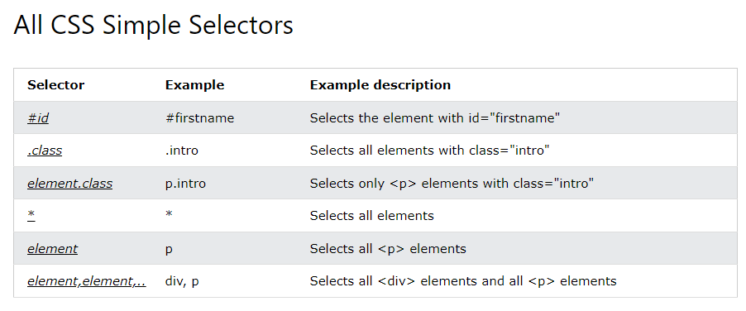
Example
In this example we have grouped the selectors from the code above:
h1, h2, p { text-align: center; color: red; }

Slide 19
Class selector (vs) ID selector
Difference between Class and ID: A Class name can be used by multiple HTML elements, while an ID name must only be used by one HTML element within the page.

Slide 20
Background image and color:
<style>
body {
background-image: URL("paper.gif");
background color: light blue;
}
</style>

Slide 21
By default, the background-image property repeats an image both horizontally and vertically.
Showing the background image only once is also specified by the background-repeat property:
The background-position property is used to specify the position of the background image.
left top, left center, left bottom, right top, right center, right bottom, center top, center, center bottom

Slide 22
The background-attachment property specifies whether the background image should scroll or be fixed (will not scroll with the rest of the page):
body { background-image: url("img_tree.png"); background-repeat: no-repeat; background-position: right top; background-attachment: fixed; }
fixed or scroll.

Slide 23
Multiple background images:
<style>
body {
background-image: URL("img_tree.gif"), URL("paper.gif");
background-repeat: no-repeat, repeat;
background-color: #cccccc;
}
</style>

Slide 24
CSS margins:
CSS has properties for specifying the margin for each side of an element:
margin-top
margin-right
margin-bottom
margin-left

Slide 25
<style>
div {
border: 1px solid black;
margin-top: 300px;
margin-bottom: 100px;
margin-right: 150px;
margin-left: 80px;
background color: light blue;
}
</style>

Slide 26
CSS lists:
The CSS list properties allow you to:
Set different list item markers for ordered lists
Set different list item markers for unordered lists
Set an image as the list item marker
Add background colors to lists and list items
Two types of lists:
Ordered list
Unordered list

Slide 27
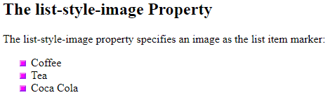
The list-style-type property specifies the type of list item marker.
The list-style-image property specifies an image as the list item marker.

Slide 28
<html>
<head>
<style>
ul {
list-style-image: url('sqpurple.gif');
}
</style>
</head>
<body>
<h2>The list-style-image Property</h2>
<p>The list-style-image property specifies an image as the list item marker:</p>
<ul>
<li>Coffee</li>
<li>Tea</li>
<li>Coca Cola</li>
</ul>
</body>
</html>

Slide 29
Position The List Item Markers
The list-style-position property specifies the position of the list-item markers (bullet points).
"list-style-position: outside;" means that the bullet points will be outside the list item. The start of each line of a list item will be aligned vertically. This is the default:
The list-style-position property specifies the position of the list-item markers (bullet points).
"list-style-position: outside;" means that the bullet points will be outside the list item. The start of each line of a list item will be aligned vertically.
list-style-position: inside;" means that the bullet points will be inside the list item. As it is part of the list item, it will be part of the text and push the text at the start:

Slide 30
CSS Tables:
To specify table borders in CSS, use the border property.
The example specifies a solid border for <table>, <th> and <td> elements:
table, th, td { border: 1px solid; }
table { width: 100%; }

Slide 31
Adjusting height
table { width: 100%; } th { height: 70px; }

Slide 32
Table alignment:
td { text-align: center; }
Vertical alignment:
The vertical-align property sets the vertical alignment (like top, bottom, or middle) of the content in <th> or <td>
td { height: 50px; vertical-align: bottom; }

Slide 33
Horizontal Alignment:
The text-align property sets the horizontal alignment (like left, right, or center) of the content in <th> or <td>.
By default, the content of <th> elements are center-aligned and the content of <td> elements are left-aligned.
To center-align the content of <td> elements as well, use text-align: center

Slide 34
Types of CSS:
There are three types of CSS which are given below:
Inline CSS
Internal or Embedded CSS
External CSS

Slide 35
External CSS
With an external style sheet, you can change the look of an entire website by changing just one file!
Each HTML page must include a reference to the external style sheet file inside the <link> element, inside the head section.
Example
External styles are defined within the <link> element, inside the <head> section of an HTML page:

Slide 36
<!DOCTYPE html> <html> <head> <link rel="stylesheet" href="mystyle.css"> </head> <body> <h1>This is a heading</h1> <p>This is a paragraph.</p> </body> </html>
An external style sheet can be written in any text editor, and must be saved with a .css extension.
The external .css file should not contain any HTML tags.
Here is how the "mystyle.css" file looks:

Slide 37
"mystyle.css"
body {
background-color: lightblue;
}
h1 {
color: navy;
margin-left: 20px;
}
Note: Do not add a space between the property value and the unit:
Incorrect (space): margin-left: 20 px;
Correct (nospace): margin-left: 20px;

Slide 38
Internal CSS
An inline style may be used to apply a unique style for a single element.
To use inline styles, add the style attribute to the relevant element. The style attribute can contain any CSS property.
Example
Internal styles are defined within the <style> element, inside the <head> section of an HTML page:
<!DOCTYPE html>
<html>
<head>
<style>
body {
background-color: linen;

Slide 39
<!DOCTYPE html> <html> <head> <style> body { background-color: linen; } h1 { color: maroon; margin-left: 40px; } </style> </head> <body> <h1>This is a heading</h1> <p>This is a paragraph.</p> </body> </html>

Slide 40
Inline CSS
An inline style may be used to apply a unique style to a single element.
To use inline styles, add the style attribute to the relevant element. The style attribute can contain any CSS property.
Example
Inline styles are defined within the "style" attribute of the relevant element:
<!DOCTYPE html>
<html>
<body>
<h1 style="color:blue;text-align:center;">This is a heading</h1>
<p style="color:red;">This is a paragraph.</p>
</body>
</html>
Tip: An inline style loses many of the advantages of a style sheet (by mixing content with presentation). Use this method sparingly.

Slide 41
Multiple Style Sheets
If some properties have been defined for the same selector (element) in different style sheets, the value from the last read style sheet will be used.
Assume that an external style sheet has the following style for the <h1> element:
h1 { color: navy; }
Then, assume that an internal style sheet also has the following style for the <h1> element:
h1 { color: orange; }

Slide 42
Example
If the internal style is defined after the link to the external style sheet, the <h1> elements will be "orange":
<head>
<link rel="stylesheet" type="text/CSS" href="mystyle.css">
<style>
h1 {
color: orange;
}
</style>
</head>

Slide 43
Example
However, if the internal style is defined before the link to the external style sheet, the <h1> elements will be "navy":
<head>
<style>
h1 {
color: orange;
}
</style>
<link rel="stylesheet" type="text/css" href="mystyle.css">
</head>

Slide 44
CSSLinks
You can use CSS styles to style any link.
Links can be styled in different ways by using any CSS property like color, or font family.
Links can be in one of the following states:
➢a: link–Unvisited link
➢a: visited–A link that the user has visited
➢a: hover–A link over which the mouse pointer is moving
➢a: active–A link, which has been just clicked
Links can be styled according to their states

Slide 45
<html>
<head>
<style>
a: hover {
background-color: yellow;
}
</style>
</head>
<body>
<h1>Demo of the :hover selector</h1>
<p>The: hover selector style links on mouse-over:</p>
<a href="https://www.w3schools.com">w3schools.com</a>
<a href="https://www.wikipedia.org">wikipedia.org</a>
</body>
</html>

Slide 46
div
The div tag is a block-level HTML element. It is used to divide or section other HTML elements into groups.
<html>
<head>
<style>
div.sample {width:150px;background:#FF0002;border:2px dotted black;padding:7px;}
div.sample ul {color:green;}
</style>
</head>
<body>
<div class="sample"> <p>Samplep> <ul> <li>Home</li> <li>Aboutus</li> <li>Contactus</li> </ul> </div>
</body>
</html>

Slide 47
span
span tag is used for some hexadecimal codes like six-digit codes that represent the amount of color is also specified the percentage values.
<html>
<body>
<p>Sample<span style="color:#FF0002;"> <i>Welcome</span></i>
Welcome My Domain</p>
<p><span style="color:#8865ff;"> Welcome to My Domain</span></p>
</body>
</html>

